Slide 1
ORGANISATIONAL BEHAVIOUR
Dr.R.Prabhu

Slide 2
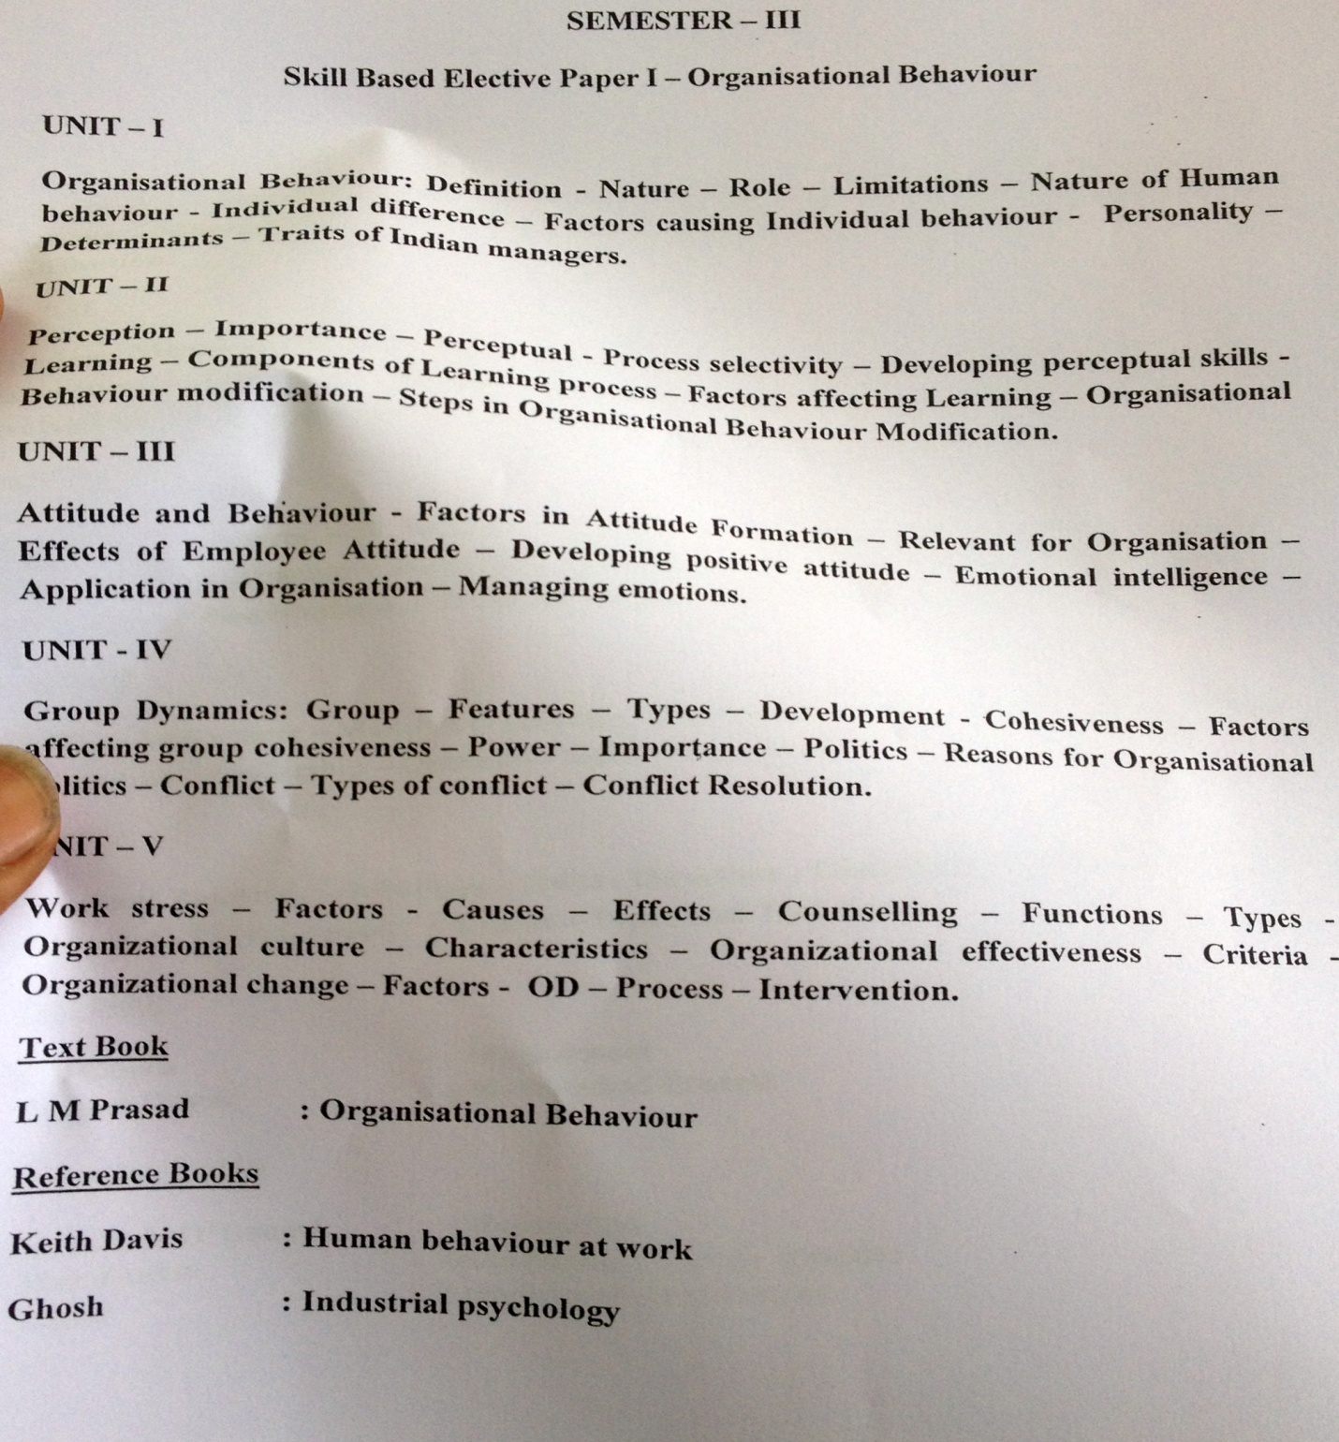

Slide 3
Organizational Behaviour
People behave differently in different situations or environment
Child
IPS Officer
Businessman
Professor
Medical Officer
Collector etc etc

Slide 4
What is organization?
Stephen P. Robbins and Timothy A. Judge’s Definition
“Organization is a consciously co-ordinated social unit, composed of two or more people, that functions on a relatively continuous basis to achieve a common goal or a set of goals”.

Slide 5
Characteristics of an Organization
An organization is created deliberately or consciously. Anything which is formed as a natural sequence such as a family or a tribal group may not be termed as an organization. Typical organizations are manufacturing companies, marketing firms, trading houses, transport offices, banks, colleges, hotels, hospitals, etc.,
It is composed of two or more people. Any business run by one individual cannot be termed as a business organization. In large organizations the number of people runs into lakhs.
There is co-ordination among the people working in an organization. In the absence of co-ordination/co-operation among the people the organization gets disorganized and ceases to exist.
There is hierarchy in any organization. A typical hierarchy consists of Board of Directors, Chairman, Managing Director, General Managers, Dy. General Managers, Senior Managers, Managers, Supervisors and Workers in a large manufacturing firm. Principal, Heads of Departments, Professors, Associate Professors and Asst. Professors form the hierarchy in a professional college. Each level of hierarchy will have its own authority and responsibility.
Organizations function continuously. There are business houses existing for over centuries. In certain cases the business may be seasonal [selling of crackers, marketing of a particular variety of fruit and etc.,] but still it is organized business.
organization will have certain goal(s). For a hospital, the goal could be to offer quality medical service at an affordable cost. A star hotel’s goal could be to offer a luxurious stay. The goal of a management school could be to make the students industry-ready. Depending on the top management the goals of a corporate could be to offer quality goods/service, invent newer and newer product designs, sell products at the cheapest rate or make available its services round the clock. Every
Show Picture

Slide 6
Behaviour
Behaviour is a response to a stimulus which is observed directly or indirectly. Human behaviour is a function of person and environment i.e. B=f [PxE].
“Person” includes education, skills, experience, health, gender, age, attitude, aptitude, beliefs, perception, personality, etc., Environment covers working conditions, amenities, supervision, rewards, fellow workers, motivation etc.

Slide 7
Behaviour: Overt and Covert
Overt behaviour: It is what a person does. It is the observable and measurable activity of human beings. It includes mental process like decision making or physical process like handling a machine.
Covert behaviour: This cannot be easily observed or measured (e.g.) feelings, attitudes, perception, etc.,

Slide 8
Meaning of Organizational Behavior
Organizational behaviour is the study of what people think, feel and do in and around organizations.
It is also a systematic study of individual, team and organization-level characteristics in an organization

Slide 9
Definition of Organizational Behaviour
According to Stephen P. Robbins, organizational behaviour is a field of study that investigates the impacts that individuals, groups and structure have on behaviour within organizations for the purpose of applying such knowledge toward improving an organization’s effectiveness.
Fred Luthans defined organizational behaviour as the understanding, prediction and management of human behaviour in organizations

Slide 10
  Goals of Organizational Behaviour Study
The goals of understanding organizational behavior are
to describe [how people behave under a variety of conditions /environments?]
to understand[why people behave as they do in different situations?]
to predict [how people behave in future?] and
to control [how their behaviour is controlled or managed for productive activity]
Show picture

Slide 11
Nature of Organizational Behaviour study
It is a part of management study representing behavioural approach to management
It is a human tool for human benefit.
It is interdisciplinary. That is, it is a field of study involving the integration of behavioural sciences such as psychology, sociology, anthropology etc., It is not a discipline in the usual sense.
It is an applied science seeking to fulfill employees’ needs and organizations’ objectives.
It involves individual / group behaviour and behaviour of organization itself.
It is humanistic as well as optimistic.
It is normative and value centered. While positive science suggests only cause-effect relationship, normative science prescribes how the various findings can be applied to get organizational results which are acceptable to society.
It is mostly oriented towards organizational objectives.
It is a total system.

Slide 12
Limitations of Organisational behaviour
Lack of Unified theory
Behavioural Bias
Law of diminishing returns
Unethical Manipulation of people

Slide 13
Role of Organisational Behaviour
Understanding Human Behaviour
Controlling Human Behaviour
Organisational Adoption

Slide 14
Understanding Human Behaviour
Individual level
Interpersonal Level
Group level
Intergroup Level

Slide 15
Controlling Human Behaviour
Use of Power and Sanction
Leadership
Communication
Organisational Climate

Slide 16
Organisational Adoption
This refers to the total organisational situations affecting Human Behaviour

Slide 17
Nature of Human behaviour
S-R Model (show diagram Fig 2)
S-O-R Model [stimulus-organism(sense,nervous, muscles & glands)-response] (show pictures on chapter 2 29,30,32,33)
S-O-B-C Model
S Overt and Covert stimuli
O Physiological being and cognitive mediator
B Overt and Covert behaviour
C Overt and Covert consequences

Slide 18
Individual Differences
People differ in the importance they attach to intrinsic rewards to the job.
People differ in the type of compensation plan they want or desire.
People differ in the style of supervision.
People differ in their preferred schedules of work hour.
People differ in their tolerance for stress.

Slide 19
Foundations of Individual behaviour
Factors in Individual Behaviour
1. Physiological
a. Intelligence
b. Physical Abilities
c. Age
d. Gender
e. Race
2. Socio-psychological
a. Personality
b. Perception
c. Learning
d. Attitudes and values
e. Emotional Intelligence
f. Motivation

Slide 20
Factors causing individual differences
Individual behaviour is caused by
1. Individual Variables
A. Physiological variables
B. Socio-psychological variables
2. Situational Variables
A. Organisational Variables
B. Job Variables

Slide 21
1. Individual Variables
A. Physiological variables
i. Intelligence
ii. Physical abilities
iii. Age
iv. Gender
v. Race
B. Socio-psychological variables
i. Personality
ii. Perception
iii. Learning
iv. Attitudes and values
v. Emotional Intelligence
vi. Motivation

Slide 22
2. Situational Variables
A. Organisational Variables
i. Organisational structure
ii. Organisational processes
iii. Organisational culture
B. Job Variables
i. Nature of Job
ii. Work Environment

Slide 23
PERSONALITY
The term ‘personality’ has been derived from the Latin
word ‘persona’ which means ‘to speak through.’
This Latin term denotes the masks which the actors used to wear in ancient Greece and Rome

Slide 24
Personality should include:
- external appearance and behaviour
- inner awareness of self as a permanent organizing force and
- particular pattern of measurable traits, both inner and outer.

Slide 25
Definition of Personality
Personality cannot be defined precisely.
There are many definitions -
“Personality is the sum total of characteristic pattern of thinking, feeling and behaving that constitutes the individual’s distinctive method of relating to environment.”

Slide 26
Determinants of Personality
The determinants of personality are:
Biological factors
Family and social factors
Cultural factors and
Situational factors

Slide 27
Determinants of Personality
Biological Factors
Family and Social Factors
Individual Personality
Situational Factors
Cultural Factors

Slide 28
1. Influence of biological factors on personality
Heredity
Brain
Physical features

Slide 29
2. Influence of family/social factors on Personality
Socialization
Identification process
  Home environment
  Family members
  Social groups
                show picture on chapter 4, pg 76 & 77

Slide 30
3. Cultural factors and personality
  Culture is the underlying determinant of human decision–making. It generally determines attitudes toward independence, aggression, competition and co-operation.
  Each culture expects and trains its members to behave in the ways that are acceptable to the group.
  To a greater extent, the child’s cultural group decides its values / characteristics through group learning
  show picture on chapter 4, page 77

Slide 31
4. Influence of situational factors on personality
The S-O-B model of human behaviour gives more importance to situations. Research studies have suggested that situation plays a powerful role in human personality. Situations bring in pressure to influence one’s personality.
Example. A care-free son becomes highly responsible when his father, the only bread – winner in the family, dies. The situation, i.e. death of father, has transformed an irresponsible son into a responsible person.

Slide 32
Traits of Indian Managers
Indian managers generally exhibit the following traits
Indian mangers are somewhat emotional, casual, sensitive, tough, tense and group dependant
On two personality characteristics of authoritarianism and machivelliansm
They have need for achievement and competence though they have lower level of maturity and persistency
They show co-operation, friendliness, sympathy and nurturance.

Slide 33
UNIT – 2
PERCEPTION
What is perception?
Perception is a process by which individuals organize and interpret their sensory impressions to give meaning to their environment. Perception could be explained in various ways.
It is the process of receiving information about and making sense of the world around people.
It is also the process of deciding which information to notice, how to categorize the noticed information, and how to interpret it within the framework of one’s existing knowledge.
In simple terms, perception is how one looks at the world
SHOW PICTURE ON PAGE 99 CHAPTER 5

Slide 34
Factors that influence perception
Show fig 32 on page 100 chapter 5

Slide 35
Perceptual process
Perceptual process consists of several sub-processes. It is an input-output process.
Here, the stimuli, namely, the environment, subject, events or people can be considered as inputs.
These inputs are ‘processed’ through selection, organization, and interpretation.
The outcomes are opinions, feeling and attitudes etc. which ultimately decide the behaviour of the people.

Slide 36
Simplex and complex process of Perception
show fig 24a and fig33 on page 101 chapter 5

Slide 37
Factors influencing perceptual selectivity
Perception is a selective process as people can select only a limited amount of information in the environment.
Through selection, certain aspects of stimuli which are admitted /accepted remain in the minds of people for interpretation.
For example, when people read newspapers, they do not read all the columns; they concentrate on the items in which they are interested.
Perceptual selectivity is caused by two categories i.e. external and internal

Slide 38
External factors in perceptual selectivity
Size
Intensity
Repetition
Familiarity
Novelty
Contrast
Motion

Slide 39
Internal factors in perceptual selectivity
Self –concept
Beliefs
Expectations
Inner needs
Response disposition
Response salience
Perceptual defense

Slide 40
Developing Perceptual Skills
Empathy is a person’s understanding and sensitivity to the feelings, thoughts and situation of others.
Empathy has both cognitive [thinking] and emotional component. The cognitive component, sometimes called perspective thinking, represents a cognitive awareness of another person’s situational and individual circumstances.
Empathizing with others improves a person’s sensitivity to external causes of another person’s performance and behaviour, thereby reducing fundamental attribution error.
Empathy towards others improves through feedback.
Improving empathy is putting oneself in the other person’s shoes. That is, placing oneself in the opposite party’s situation and then arguing.
The more a person personally experiences the environment in which other people live and work, the better he will understand and be sensitive to their needs and expectations.

Slide 41
LEARNING

